Slide 1

Algebra 1
Unit 9, Lesson 6 Solving Quadratic Equations by Completing the Square Volume 2, pg. 88

Slide 2


Benchmarks
MA.912.AR.3.1
Given a mathematical or real-world context, write and solve one-variable quadratic equations over the real number system.
MA.912.AR.9.6
Given a real-world context, represent constraints as systems of linear equations or inequalities. Interpret solutions to problems as viable or non-viable options.
volume 2, pg. 88

Slide 3
Integrated Mathematical Thinking and Reasoning Standards
MA.K12.MTR.1.1 Actively participate in effortful learning both individually and collectively.
MA.K12.MTR.2.1 Demonstrate understanding by representing problems in multiple ways.
MA.K12.MTR.3.1 Complete tasks with mathematical fluency.
MA.K12.MTR.4.1 Engage in discussions that reflect on the mathematical thinking of self and others.
MA.K12.MTR.5.1 Use patterns and structure to help understand and connect mathematical concepts.
MA.K12.MTR.6.1 Assess the reasonableness of solutions.
MA.K12.MTR.7.1 Apply mathematics to real-world contexts.
volume 2, pg. 88

Slide 4

Learning Targets
I can solve a quadratic by completing the square.
I can interpret solutions to quadratics in a real-world context as viable or nonviable.
volume 2, pg. 88

Slide 5

Warm-Up
volume 2, pg. 89

Slide 6
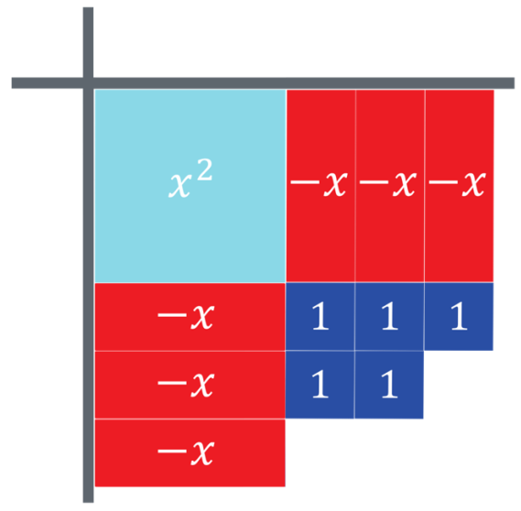
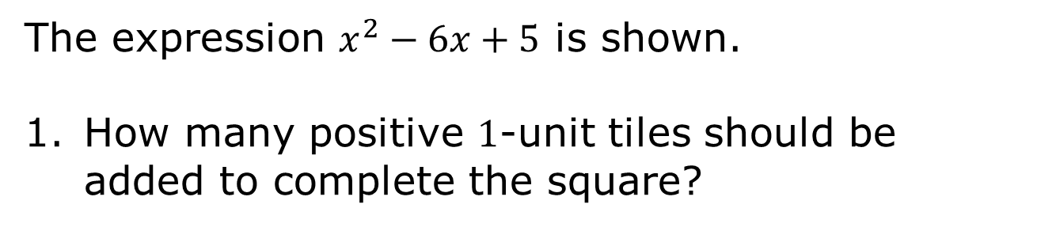
9.6.1 Warm-Up: Complete the Square
The expression $x^{2}−6x+5$ is shown.
How many positive $1$-unit tiles should be added to complete the square?
volume 2, pg. 89
Notes:
Video Link: https://algebranation.wistia.com/medias/fi4fidi5y8

Slide 7
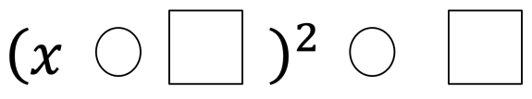
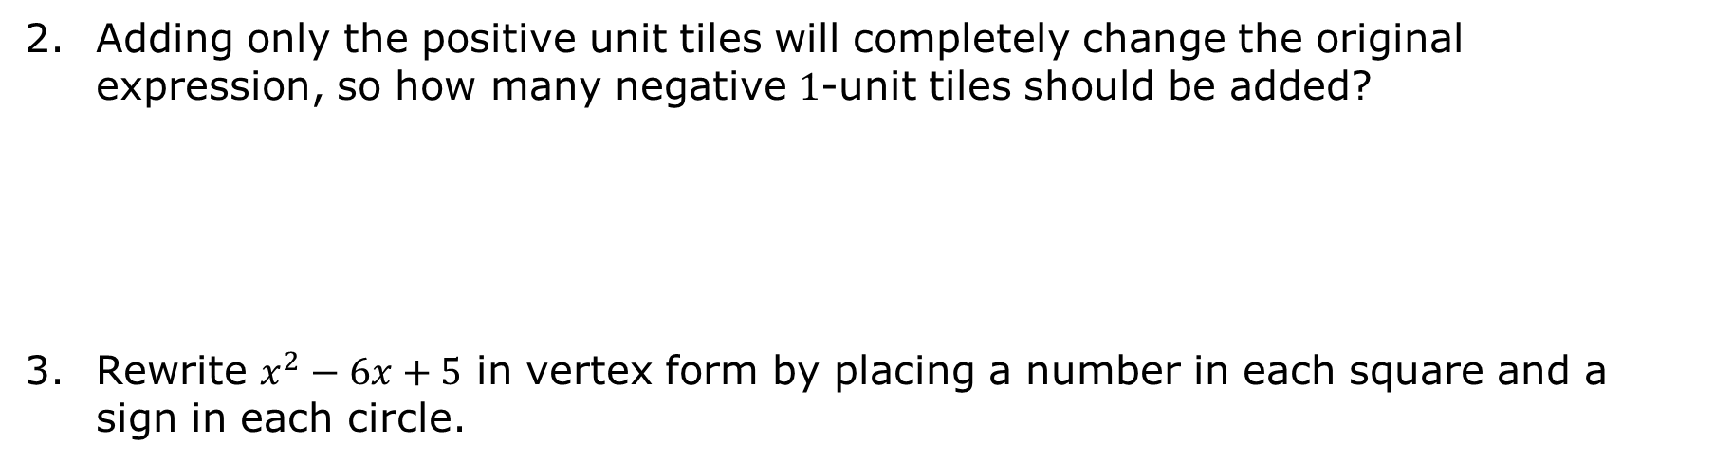
Adding only the positive unit tiles will completely change the original expression, so how many negative $1$-unit tiles should be added?
Rewrite $x^{2}−6x+5$ in vertex form by placing a number in each square and a sign in each circle.
volume 2, pg. 89

Slide 8

Guided Instruction
volume 2, pg. 89

Slide 9

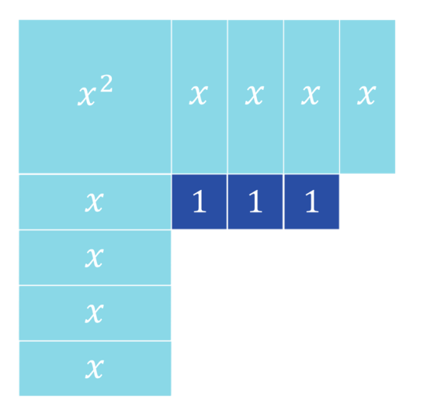
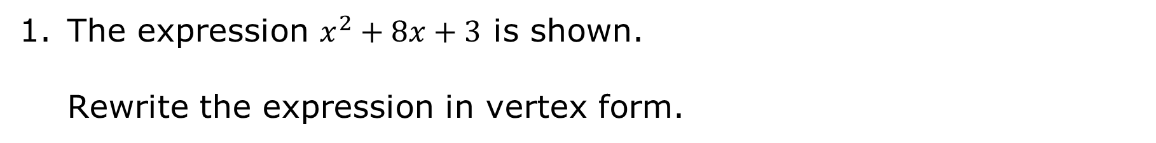
9.6.2 Guided Instruction: Solving Quadratic Equations by Completing the Square
The expression $x^{2}+8x+3$ is shown.
Rewrite the expression in vertex form.
volume 2, pg. 89

Slide 10
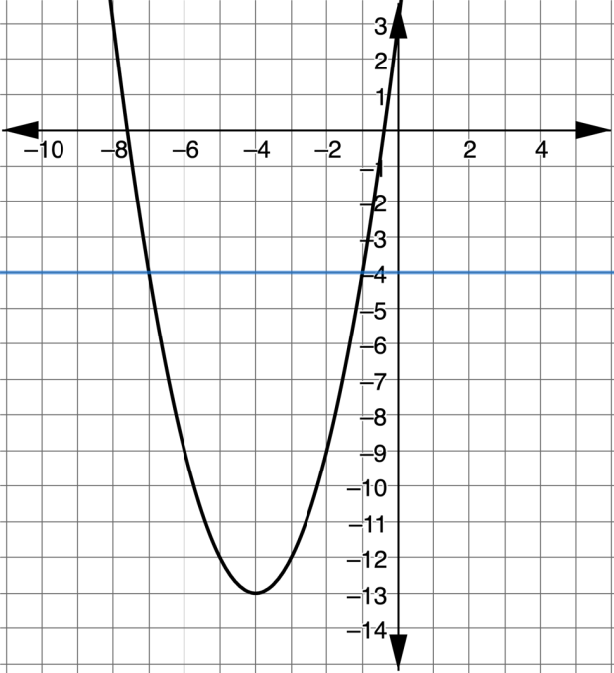

The equations $y=x^{2}+8x+3$ and $y=−4$ are shown on the coordinate grid.
Where does the line $y=−4$ intersect with the quadratic $y=x^{2}+8x+3$?
The intersections show the solutions to $x^{2}+8x+3=−4$.
volume 2, pg. 89

Slide 11
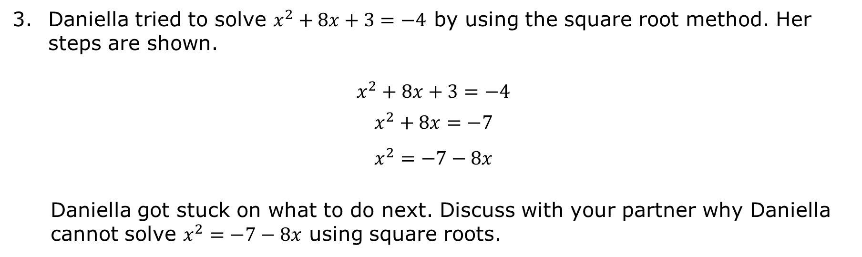
Daniella tried to solve $x^{2}+8x+3=−4$ by using the square root method. Her steps are shown.
$$x^{2}+8x+3=−4$$
$$x^{2}+8x=−7$$
$$x^{2}=−7−8x$$
Daniella got stuck on what to do next. Discuss with your partner why Daniella cannot solve $x^{2}=−7−8x$ using square roots.
volume 2, pg. 90

Slide 12
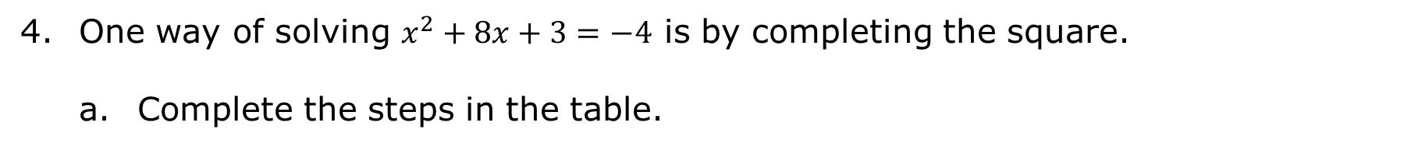
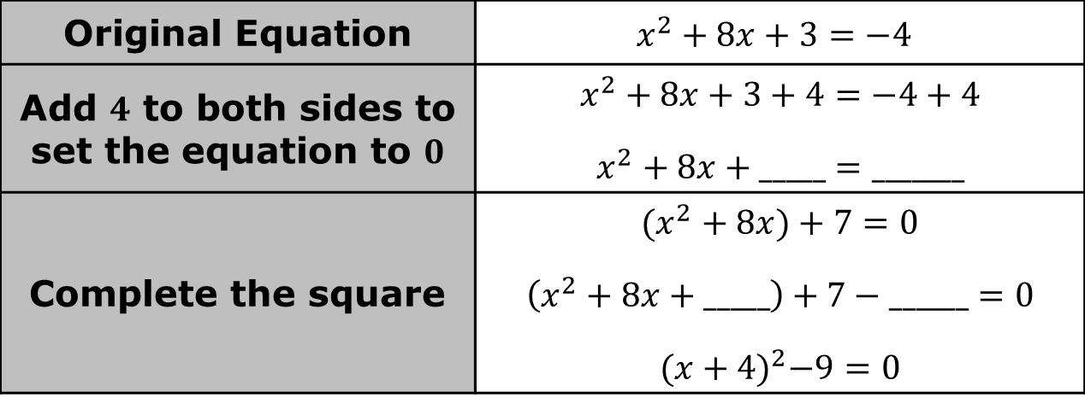
One way of solving $x^{2}+8x+3=−4$ is by completing the square.
Complete the steps in the table.
Original Equation | $$x^{2}+8x+3=−4$$
Add $4$ to both sides to set the equation to $0$ | $$x^{2}+8x+3+4=−4+4$$ $$x^{2}+8x+_____=_______$$
Complete the square | $$(x^{2}+8x)+7=0$$ $$\left(x^{2}+8x+_____\right)+7−______=0$$ $${(x+4)}^{2}−9=0$$
volume 2, pg. 90

Slide 13

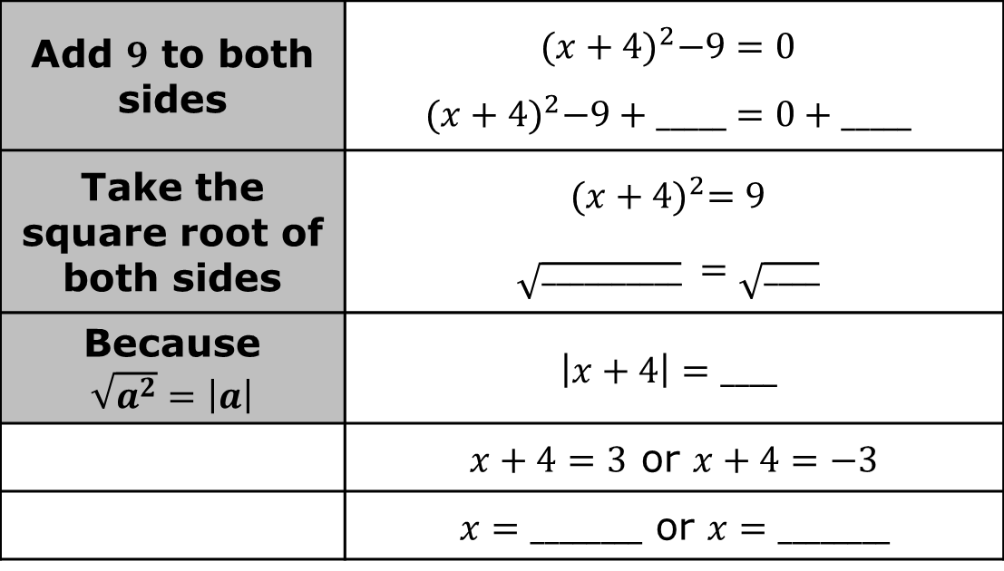
Solve ${\left(x+4\right)}^{2}−9=0$ by completing the steps.
Check your solutions with the intersections found using the graph.
Add $9$ to both sides | $${(x+4)}^{2}−9=0$$ $${(x+4)}^{2}−9+_____=0+_____$$
Take the square root of both sides | $${(x+4)}^{2}=9$$ $$\sqrt{__________} =\sqrt{____}$$
Because $\sqrt{a^{2}}=\left|a\right|$ | $$\left|x+4\right|=____$$
 | $x+4=3$ or $x+4=−3$
 | $x=________$ or $x=________$
volume 2, pg. 90

Slide 14

Solve $−3{\left(x−5\right)}^{2}+6=−21$.
Solve by completing the square.
$$−4x^{2}−16x−11=−3$$
volume 2, pg. 90

Slide 15

Guided Practice
volume 2, pg. 91

Slide 16

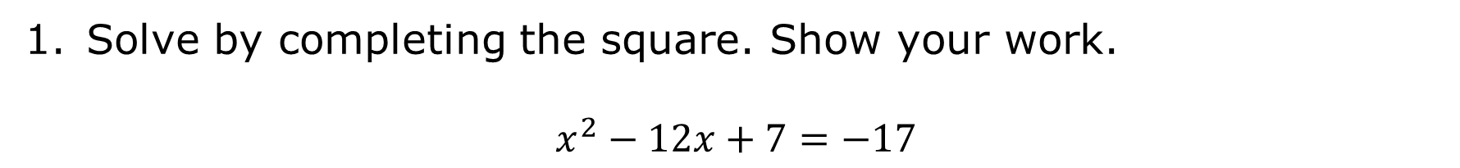
9.6.3 Guided Practice: Solving Quadratic Equations by Completing the Square
Solve by completing the square. Show your work.
$$x^{2}−12x+7=−17$$
volume 2, pg. 91

Slide 17
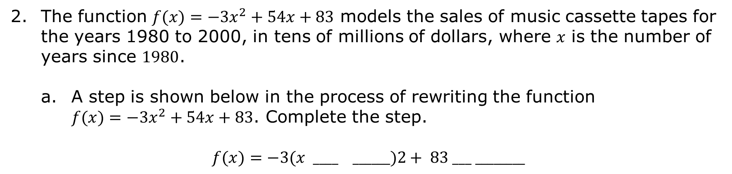
The function $f(x)=−3x^{2}+54x+83$ models the sales of music cassette tapes for the years 1980 to 2000, in tens of millions of dollars, where 𝑥 is the number of years since $1980$.
A step is shown below in the process of rewriting the function $f(x)=−3x^{2}+54x+83$. Complete the step.
$$f(x)=−3(x ____ ______)2+ 83 ___ ________$$
volume 2, pg. 92

Slide 18
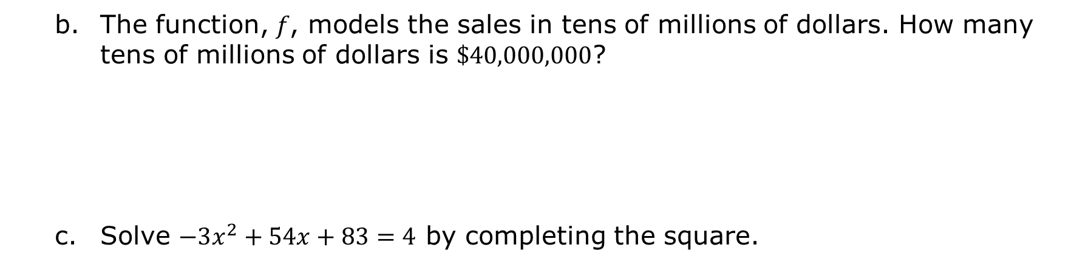
The function, 𝑓, models the sales in tens of millions of dollars. How many tens of millions of dollars is $\$40,000,000$?
Solve $−3x^{2}+54x+83=4$ by completing the square.
volume 2, pg. 92

Slide 19
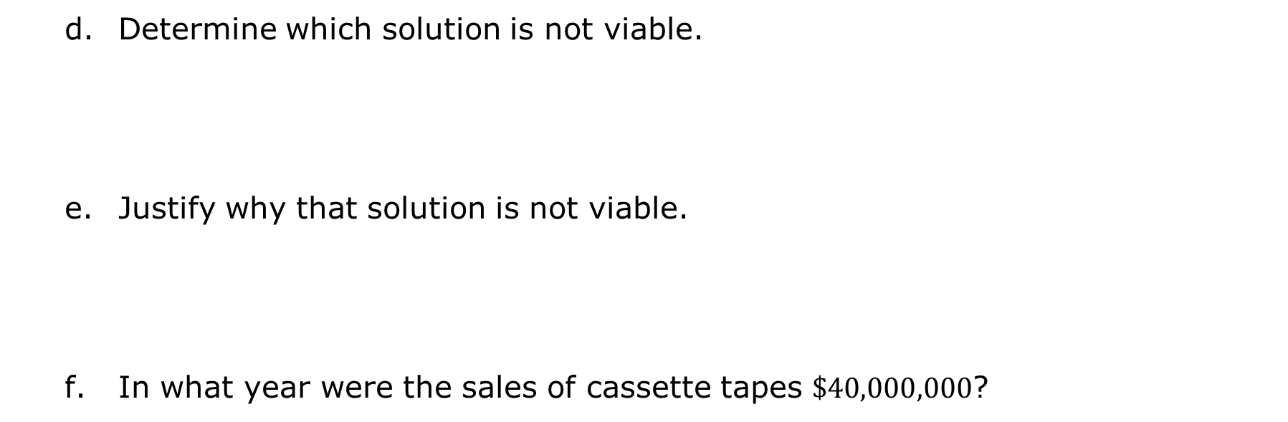
Determine which solution is not viable.
Justify why that solution is not viable.
In what year were the sales of cassette tapes $\$40,000,000$?
volume 2, pg. 92

Slide 20

Your Turn
volume 2, pg. 92

Slide 21
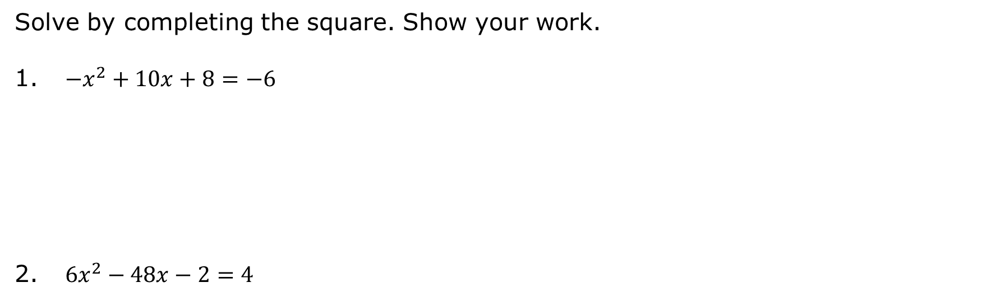
9.6.4 Your Turn!
Solve by completing the square. Show your work.
$−x^{2}+10x+8=−6$
$6x^{2}−48x−2=4$
volume 2, pg. 92

Slide 22

Wrap-Up
volume 2, pg. 93

Slide 23
9.6.5 Wrap-Up: Growth Mindset
“You may encounter many defeats, but you must not be defeated. In fact, it may be necessary to encounter the defeats, so you can know who you are, what you can rise from, how you can still come out of it.” ― Maya Angelou
What was the toughest part of today’s lesson for you?
volume 2, pg. 93

Slide 24
How did you keep going when things got tough?
Write a short note to yourself or draw a picture that celebrates your perseverance through the tough part of today’s lesson.
volume 2, pg. 93

